Slide 1
Confusion Matrix and Basic Evaluation Metrics

Slide 2
Classification Problem

Slide 3
What is a Confusion Matrix?-cp

Slide 4
True Positive (TP)

Slide 5
True Negative (TN)

Slide 6
False Positive (FP)

Slide 7
False Negative (FN)
The actual class is positive, but the model predicts negative.

Slide 8
NOTE
Correct=TP+TN
Incorrect=FP+FN

Slide 9
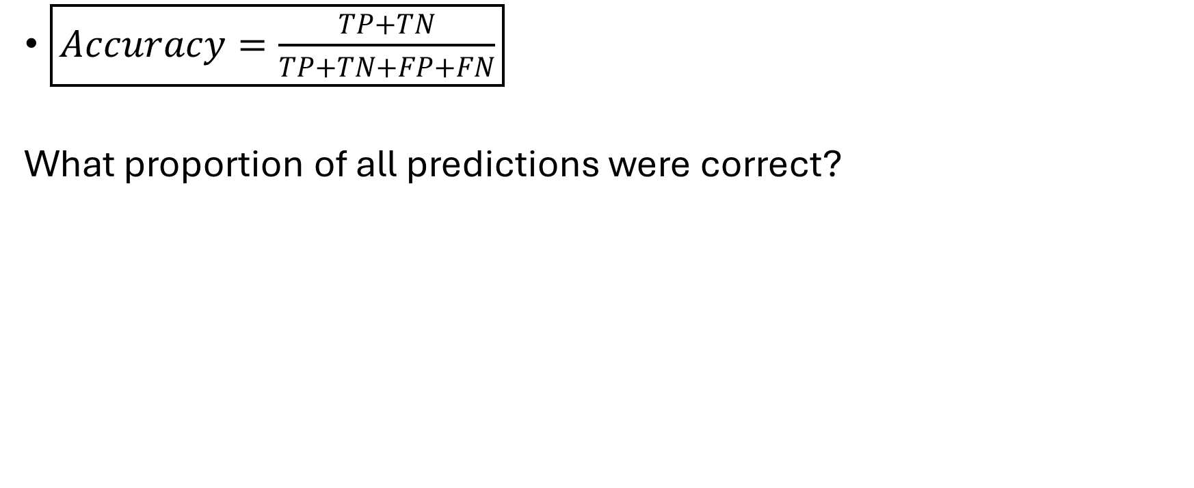
Accuracy
$\boxed{Accuracy=\frac{TP+TN}{TP+TN+FP+FN}}$
What proportion of all predictions were correct?

Slide 10
Error Rate

Slide 11
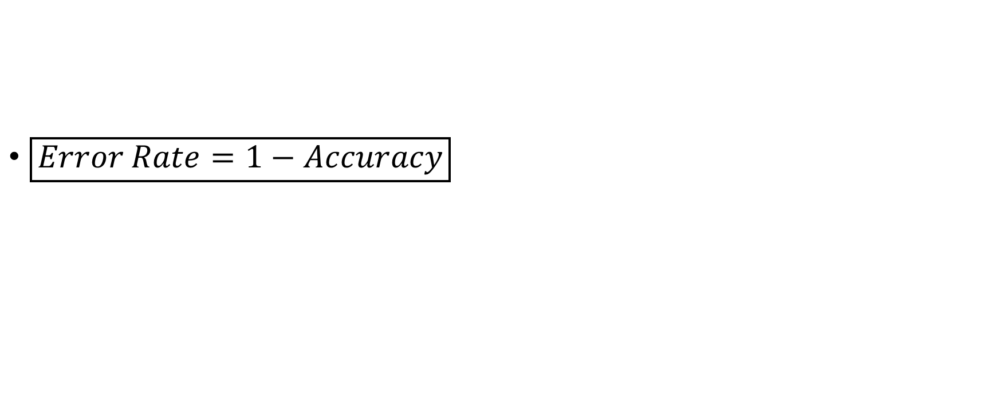
Error Rate
$\boxed{Error Rate=1−Accuracy}$

Slide 12
Precision
Out of all cases predicted as positive, how many were actually positive?

Slide 13
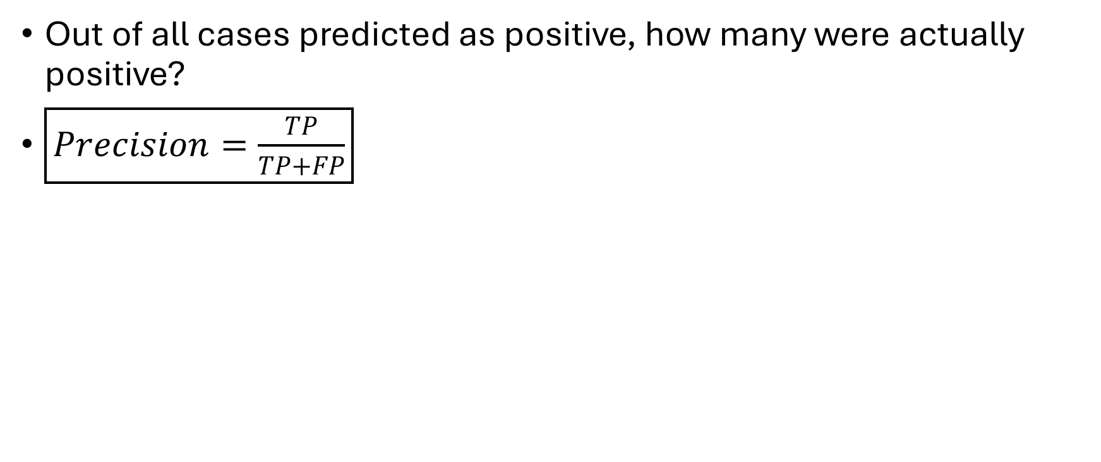
Precision
Out of all cases predicted as positive, how many were actually positive?
$\boxed{Precision=\frac{TP}{TP+FP}}$

Slide 14
Recall

Slide 15
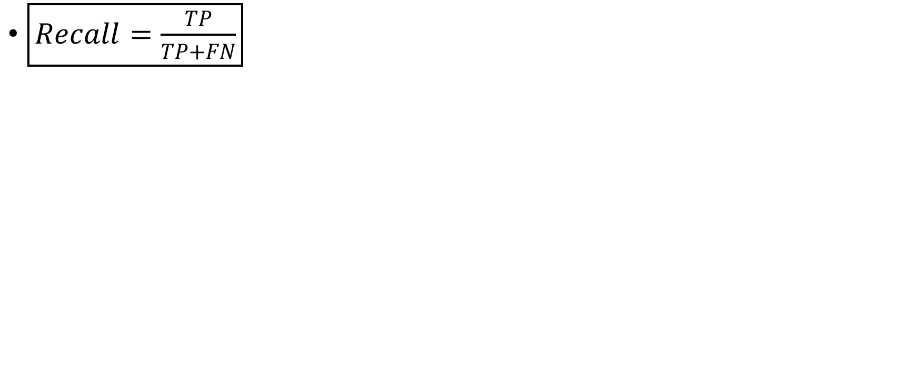
Recall
$\boxed{Recall=\frac{TP}{TP+FN}}$

Slide 16
F1-Score

Slide 17
F1-Score
The F1-score is the harmonic mean of precision and recall.

Slide 18
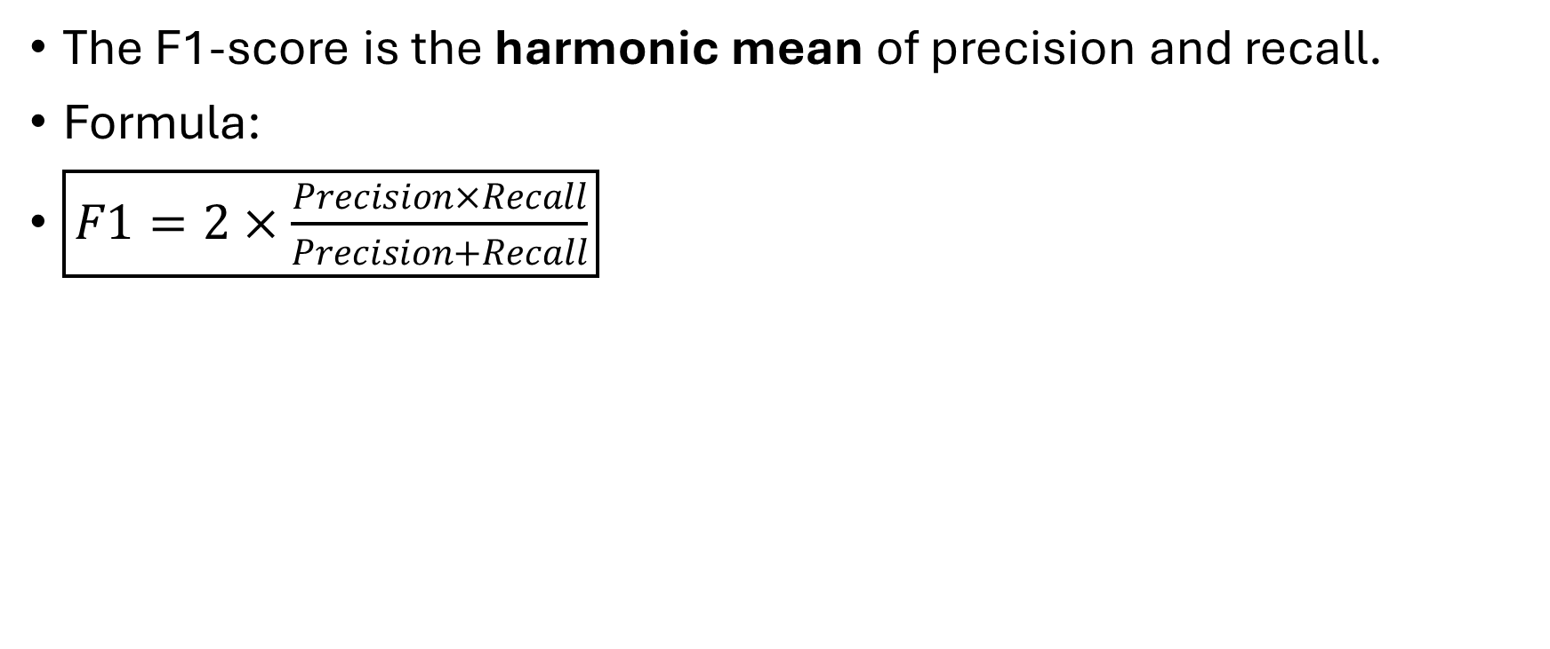
F1-Score
The F1-score is the harmonic mean of precision and recall.
Formula:
$\boxed{F1=2×\frac{Precision×Recall}{Precision+Recall}}$

Slide 19
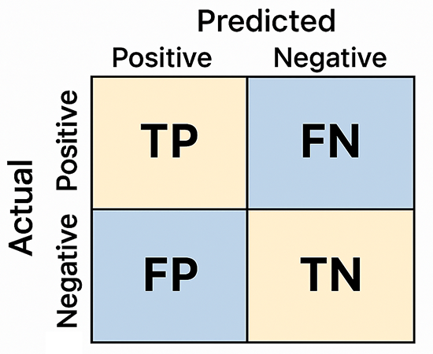

Slide 20
